Slide 1
Teaching Reproducibility, Scientific Writing, and Dissemination by "Publishing" a Classroom Journal for Student Projects
Alex Kaizer
JSM 2024
August 4, 2024

Slide 2

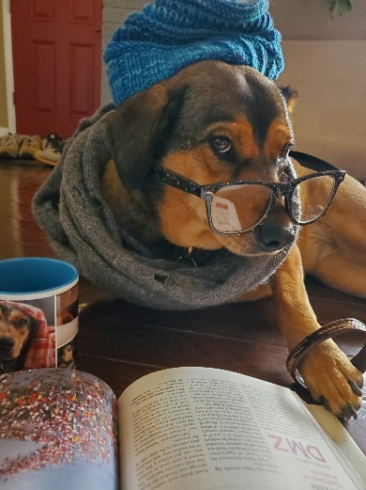
Brief Bio
Alex Kaizer
Associate Professor of Biostatistics and Informatics, University of Colorado Anschutz Medical Campus
Primarily teach graduate-level biostatistics courses (e.g., our intro methods class, clinical trials) with a flipped classroom
Work on both Bayesian trial designs and general collaborative research projects
My dog’s name is Baisy (named after Bayesian), which was thought up by my musician family

Slide 3
Learning Objectives
Develop scientific writing skillset:
Formal writing style
Formatting results for general audiences
Practice reproducible research principles:
Appropriately commented code
Setting seeds if random processes are involved
Experience process of formatting and submitting a scientific paper to a “journal”:
Following guidelines
Including informative tables and figures

Slide 4


Motivation
Microsoft Copilot AI Image of an exhausted teacher grading yet another project that only they get to see
Many classes have projects that ask students to write up their results:
Conducting a scientific study (e.g., paper airplanes for one-way ANOVA)
Implementing statistical simulations (e.g., a mini-methods paper)
Conducting a real analysis (e.g., using TSHS data sets!)
Microsoft Copilot AI Image of students exhausted after completing said project

Slide 5
Missed Opportunities with Current Approach
Students didn’t get to see how their peers approached the project:
Learn new coding approaches
Examine how different hypotheses were formed
See different strategies to addressing similar problems
As an instructor in a graduate program, many of my students will (unknowingly) have a future filled with writing:
Thesis or capstone projects
Peer reviewed collaborative research papers
Peer reviewed statistical methods papers

Slide 6
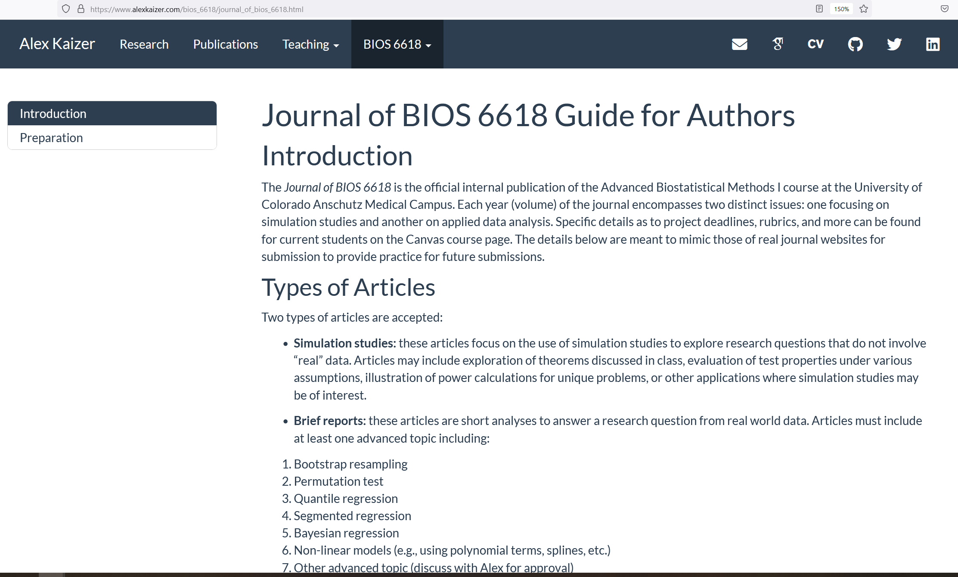
Created a “Journal Formatting” HTML
To mimic the (sometimes vague) process of article formatting, one can create their own “Guide for Authors”
www.alexkaizer.com/bios_6611 and www.alexkaizer.com/bios_6618 have examples publicly available

Slide 7
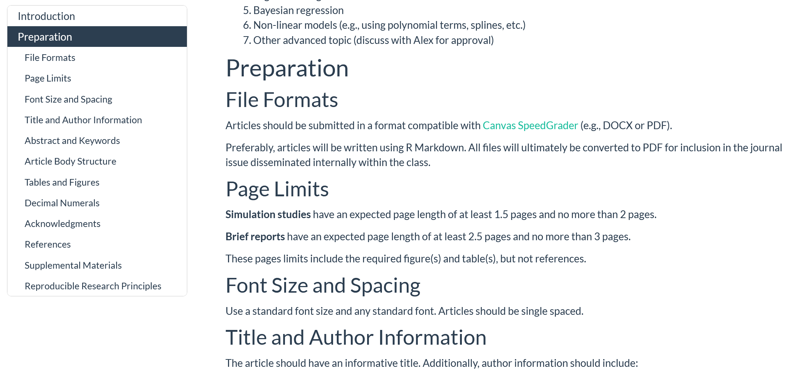
Anatomy of a “Journal Formatting” Page
Rmd/Qmd can provide interactive tables of contents
Highlight reproducibility (e.g., code, setting seeds, etc.)
Rmd/Qmd to HTML can be hosted on website or posted directly to Canvas/course site

Slide 8
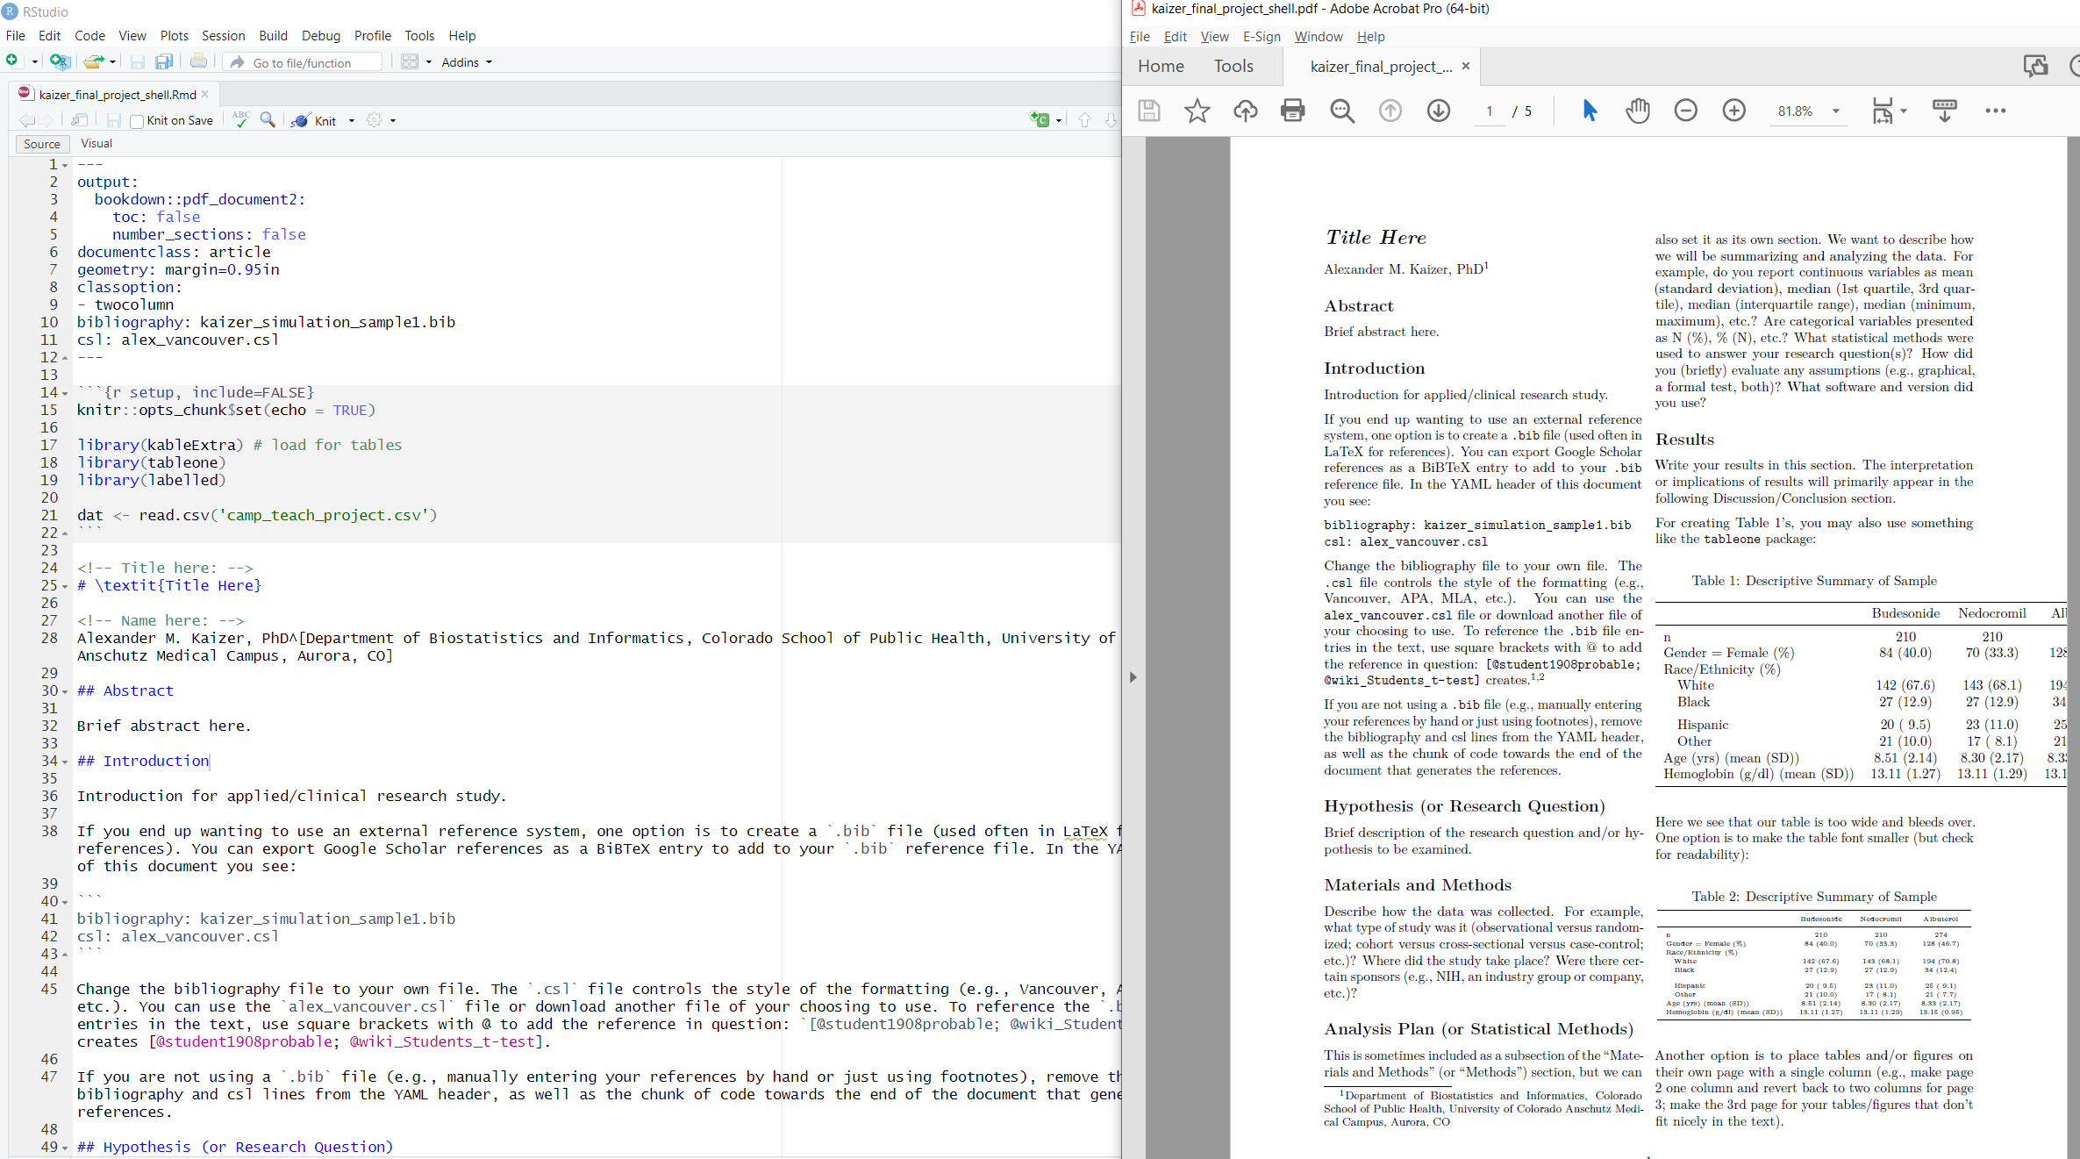
Rmd Template for Reproducible Formatting
Can help with consistency across projects
Develops markdown skill set
Encourages reproducibly created reports with Rmd/Qmd

Slide 9
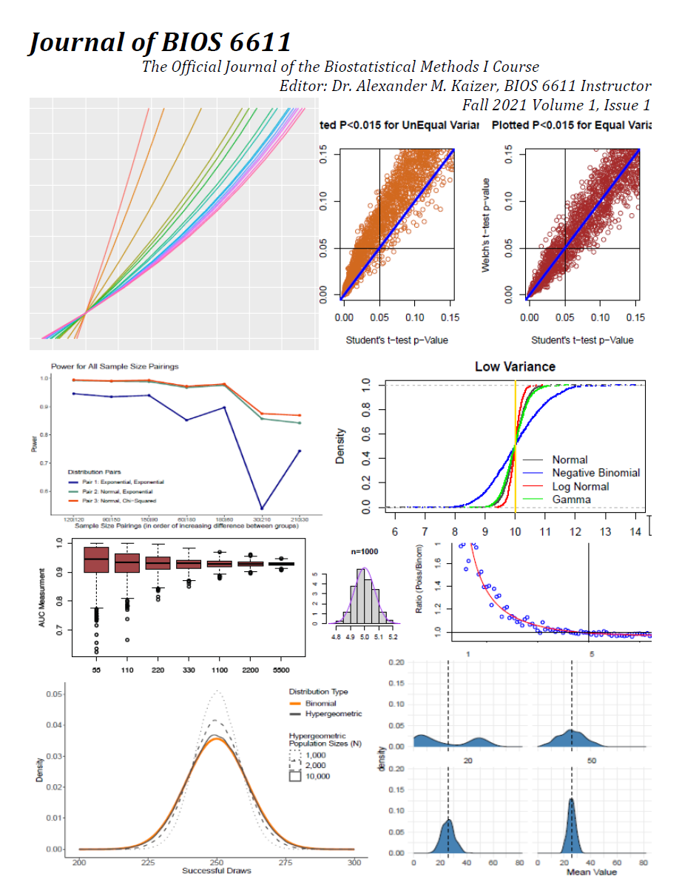
Journal of BIOS 6611
Title noting the course and that it is our “official” journal
Journal Editor (i.e., class instructor) listed to help students note someone has to ultimately do the work to review/combine
Year, Volume, and Issue (useful if multiple projects!)
Screenshots from select projects so students can get excited to see their work on the “cover”

Slide 10
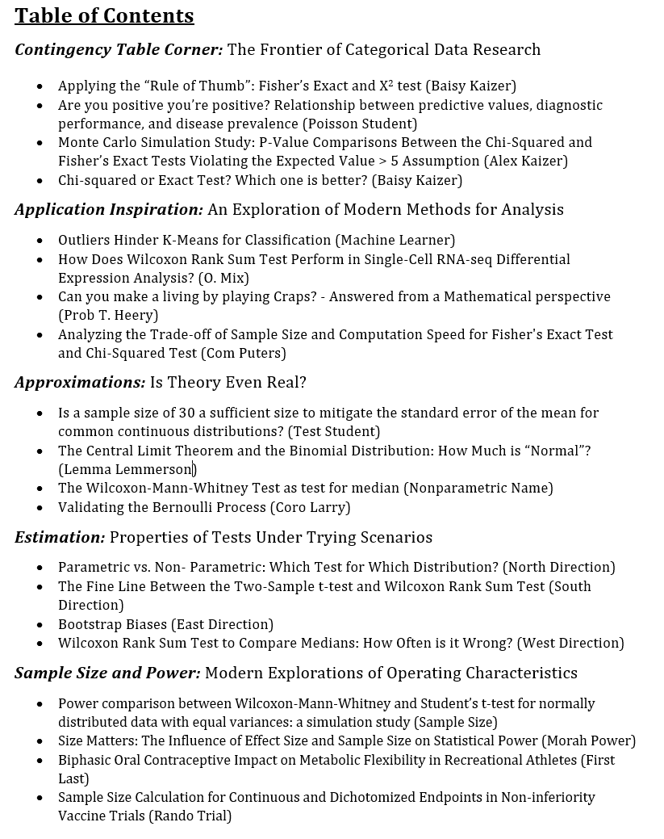
Journal of BIOS 6611
Create a hyperlinked table of contents in Adobe PDF for ease of jumping to the given article
I try to group projects into themes (with my own humor incorporated)
This example uses real titles with anonymized student names

Slide 11
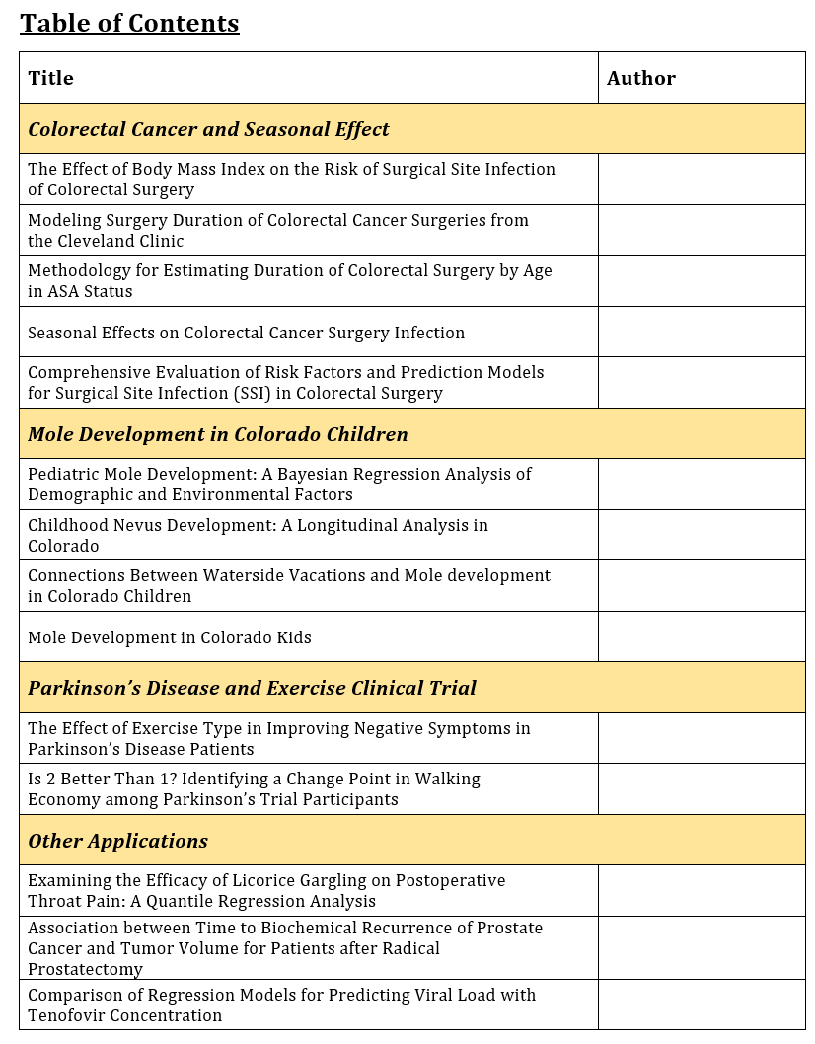
Journal of BIOS 6618 – New Formatting
Formatting can evolve based on your own time/skillset. This ToC was from my Fall 2023 BIOS 6618 class and their final project focusing on a real-world data analysis
Names removed for anonymity, but links included in the “published” PDF document to help students quickly jump to the article of interest

Slide 12
Ideas for (New) Optional Modules
Peer Review
Co-Authored Publications
Working to incorporate a “peer review” phase where students will review the work of their peers prior to final submission for feedback
Could include grading elements related to providing feedback
Potential challenge in addressing “imposter” syndrome
In my own class, projects are based on single authors and students do not actively work together
Could instead assign groups to work together and divide labor amongst the various tasks
Could incorporate peer-based evaluation of contributions

Slide 13

Student Feedback
Excitement with being able to see what their friends ultimately ended up doing
Learning different approaches to setting up code for simulation studies or statistical models
Enjoy having a “keepsake” to refer to for future questions
Microsoft Copilot AI Image of students excited to get the recently published Journal of BIOS 6618

Slide 14
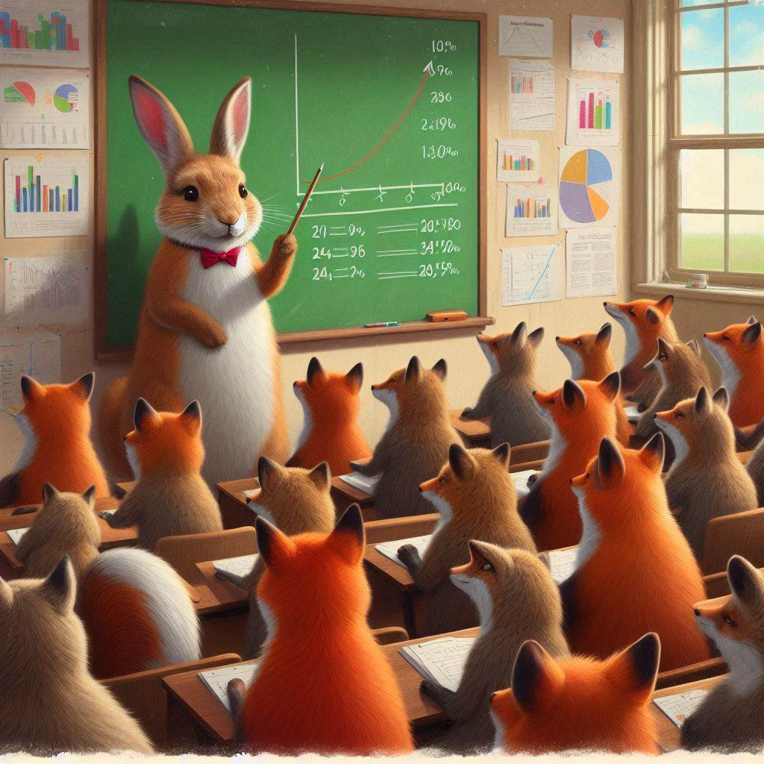
Some Potential Challenges
Access to proper software to combine student papers/projects (e.g., Adobe PDF)
Comfort with scientific writing may vary by students
Some students may not want to share their work
Microsoft Copilot AI Image of “inspirational image of a rabbit teaching a classroom of foxes about statistics”

Slide 15

Contact Info:
Email:
alex.kaizer@cuanschutz.edu
Website: www.alexkaizer.com (can find course websites under “Teaching”)
GitHub: alexbiostats
Questions?

